Slide 1
Overview
CSE 365 – Information Assurance
Fall 2019
Adam Doupé
Arizona State University
http://adamdoupe.com

Slide 2
What is security?

Slide 3
Components of Security
Confidentiality
Access Control
Encryption
Integrity
Prevention
Detection
Availability
Denial of Service

Slide 4
Threats
Disclosure
Deception
Disruption
Usurpation

Slide 5
Common Threats
Snooping (wiretapping)
Modification/alteration
Man-in-the-middle (MITM)
Masquerading/spoofing
Delegation?
Repudiation
Denial of receipt
Delay
Denial of service

Slide 6
How to Defend Against Threats?
Security policy
Security mechanism
Notes:
Policy: A statement of what is and what is not allowed
Mechanism: is a method, tool, or procedure for enforcing a security policy

Slide 7
Example
The system we want to defend is a house.
Threats?
Policy?
Mechanism?

Slide 8
Security Policy Goals
Prevention
Detection
Recovery

Slide 9
Defining Policies
Natural Language
Mathematics
Policy Languages

Slide 10
Correctness of Security Policy
Assumptions
What assumptions did we make in our house example?
Policy is correct
Mechanism correctly implements policy
Trust
Who do we trust?

Slide 11
Mechanisms
Technical
Procedural

Slide 12
Security Mechanism Effectiveness
Secure
Precise
Broad

Slide 13
Assurance
How to trust that the system is secure?
How much to trust the system?
Can this be quantified?
What does it depend on?

Slide 14
Specification
What is the system supposed to do?
How to define?

Slide 15
Design
How to design the system?
Does the design satisfy the specification?
How to prove this?

Slide 16
Implementation
How is the design implemented?
Does the implementation satisfy the design?
How to prove this?

Slide 17
Deployment, Configuration, Operation
How is the implementation…
Deployed?
Configured?
Operation?
How to prove this?

Slide 18
Cost-Benefit Analysis
Are security measures/mechanisms worth the cost?
What factors to consider?

Slide 19
Risk Analysis
Should an asset be protected?
What threats does it face?
What are the consequences if it is attacked?
What level to protect an asset?
Does risk remain constant?
How to quantify risk?

Slide 20
Laws/Customs
Laws can restrict policy and mechanisms
Various countries have (or have had in the past) laws regrading cryptography
Could privacy laws restrict an admin from performing their job?
Customs

Slide 21
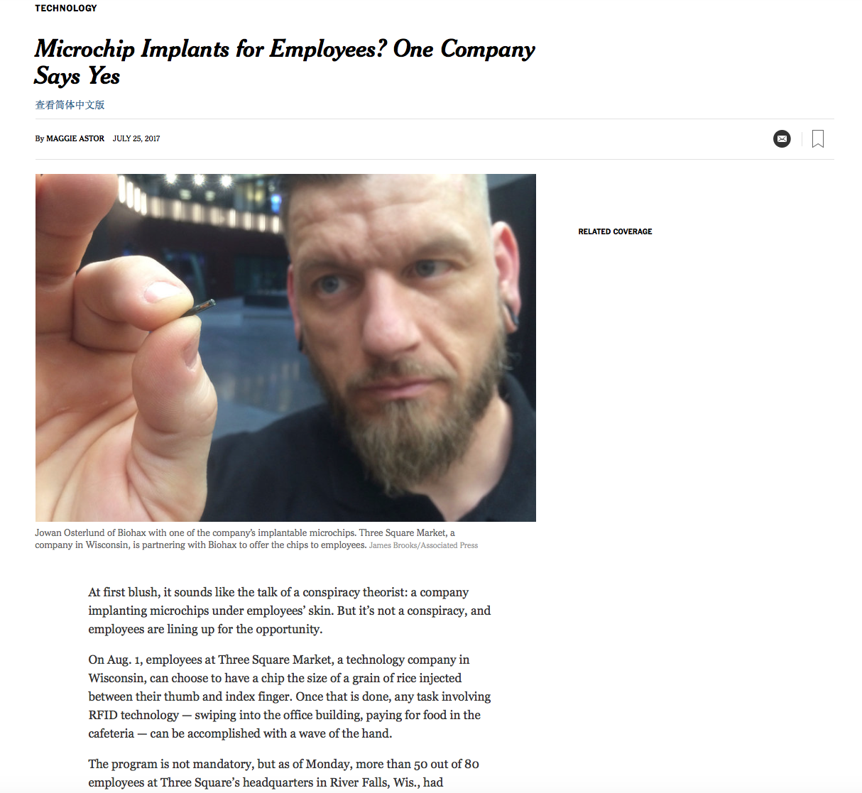

Slide 22
Human Issues
Who is responsible for security in an organization?
How much budget do they have?
How much organizational power do they have?
Who enforces the security of a system?
People and systems

